Slide 1
Vibrant Volunteers Network
Volunteers are the Lifeblood of Rural Communities
How this project has Energised a Rural Community.

Slide 2
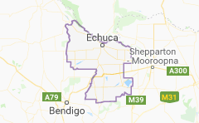
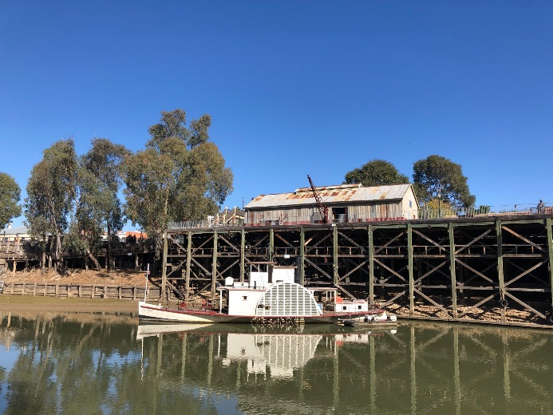
Where we are- Campaspe –Murray Region

Slide 3
https://youtu.be/Us-3RDulb4A

Slide 4
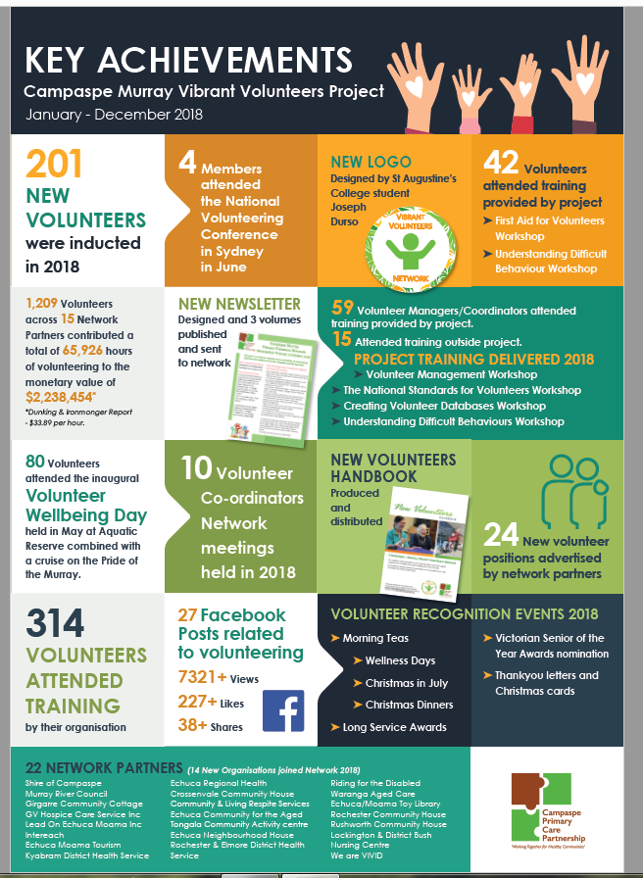

Slide 5
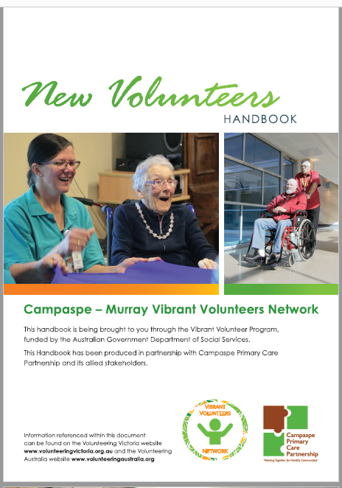
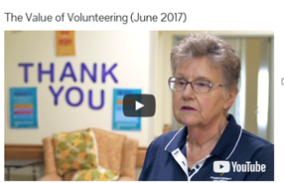
Resources Developed

Slide 6
Our Panel
Interviewer: Shari Butcher (Echuca Regional Health)
Liz Rowsell (Community Living & Respite Services)
Sue Coulston - Volunteer (Community Living & Respite Services)
Suzanna Barry –CEO (Community Living & Respite Services)
Meghan Dehne (We are Vivid)
Hazel Smith - Volunteer (Kyabram & District Health Services)

