Slide 1
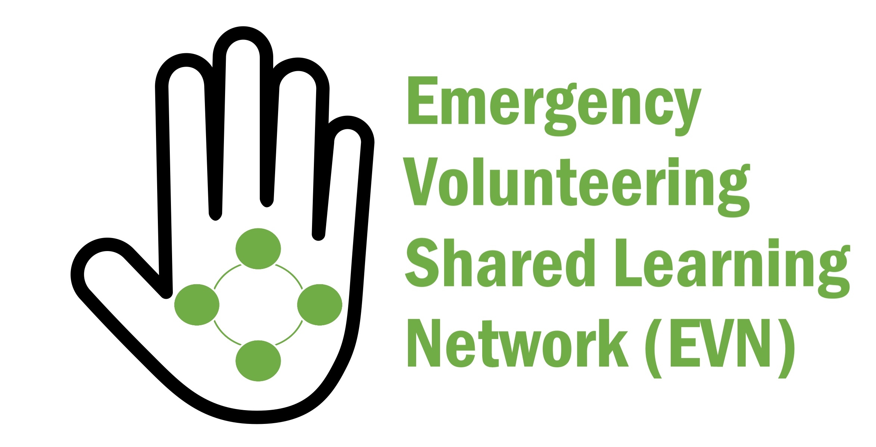
▌‘Stuck in the middle with you’ – Lessons from the Emergency Volunteering Shared Learning network
Volunteering Victoria State Conference/ 2019
Dr Blythe McLennan / RMIT University
^{blythe.mclennan@rmit.edu.au}

Slide 2
▌What do you wish researchers knew about communicating with volunteers and volunteer managers?

Slide 3
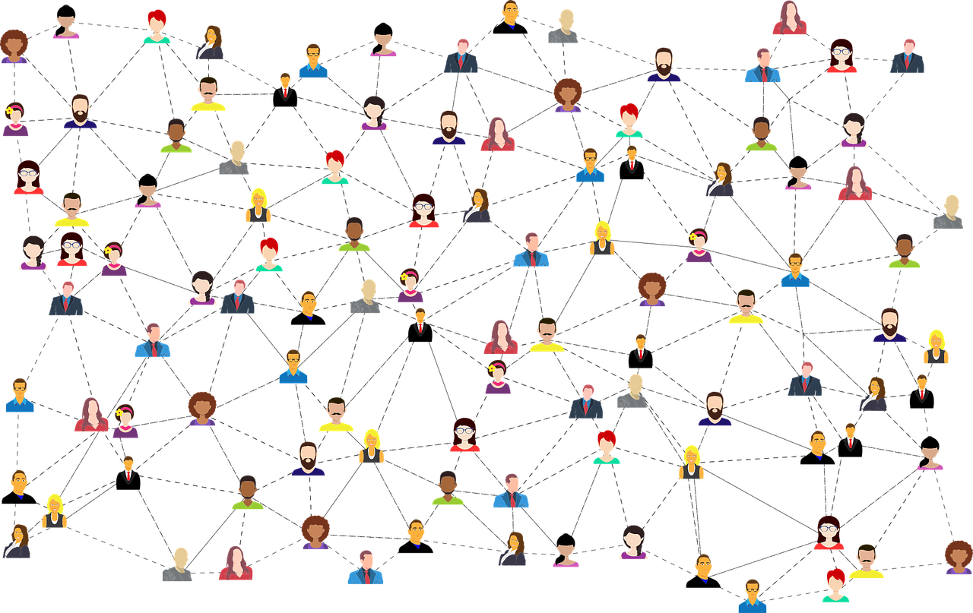
“ Knowledge networks are collections of individuals and teams who come together across organizational, spatial and disciplinary boundaries to invent and share a body of knowledge. The focus of such networks is usually on developing, distributing and applying knowledge.
Pugh, K. & Prusak, L. (2013) Designing Effective Knowledge Networks. MIT Management Sloan Review (Fall) https://sloanreview.mit.edu/article/designing-effective-knowledge-networks/

Slide 4
AIM: Enable value of emergency volunteering for communities by sharing learning
MEMBERS: 217, 37% volunteers, 65% emergency services, 67% joined to learn & improve practice
ACTIVITIES: 5 e-newsletters, 4 webinars, resource collections (260 items), 2 member surveys
ENGAGEMENT: 45% newsletter open rate, 16% click rate, ≈25 ppl per live webinar- high ratings & Qs
Volunteers are most engaged members

Slide 5
Top 3 (text box)
Recruitment, retention
Innovation, research, best practice
Community-based, non-traditional, spontaneous volunteering
Training & capabilities
▌What did people want to learn about?
Multiple choice
Future of emergency volunteering
New approaches to volunteer management
Volunteering in changing rural communities
Recruitment and retention

Slide 6
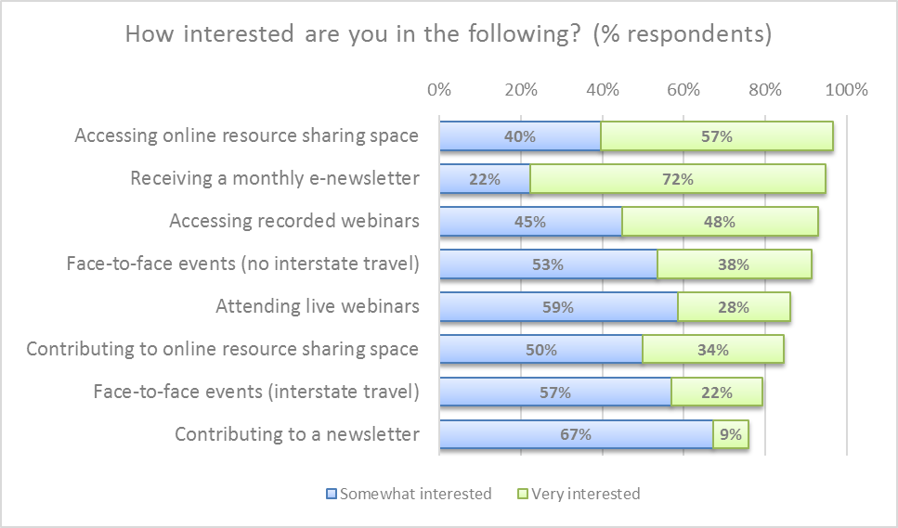
▌How did they want to do it?

Slide 7
1. Be focused & listen to members
2. Foster collaboration & encourage engagement & sharing
3. Build wide & diverse network
4. Share relevant, thought-provoking content
5. Directly connect with & support good ‘on-the-ground’ practice
6. Make research & knowledge more accessible
7. Use multiple engagement methods & platforms
8. Advocate for/ support change
▌How can the EVN achieve its goals?
SUGGESTIONS FROM MEMBERS

Slide 8
▌What worked well?
Direct, regular engagement with volunteers & volunteer managers
Improved accessibility of research
Insights from members
Reaching out with webinars

Slide 9
▌What didn’t work so well?
High time commitment - big learning curve (e.g. tech, comms)
Resource collection hasn’t reached its potential
Limited sharing of tacit knowledge (except for webinars)

Slide 10
▌What could we do next?
Members web conference
Line up group of champions/leaders
Interactive online space
Face to face opportunities
Themed study/discussion groups
Integrate with AIDR Knowledge Hub?

Slide 11
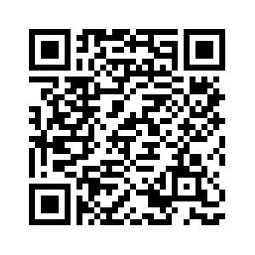
▌Thank you
“I think there is an important role the EVN can fill in providing a "broad church" as such, which communities and the EM sector can tap into, that provides access to latest learning, contacts for specialists in areas of interest etc. In particular I think that RMIT's longevity in the studies and information-sharing of disaster/ emergency related knowledge places it as an institution in a unique position of authenticity to continue this work in ways in which grassroot volunteers feel they can engage.”
▌Volunteer / Emergency service agency
Blythe McLennan RMIT University & BNHCRC
emergency.volunteering@rmit.edu.au
blythe.mclennan@rmit.edu.au
t: 0406 059 510
@viajerabj
Notes:
What do you wish researchers like me knew about communicating & sharing with volunteers and volunteer managers?

