Slide 1

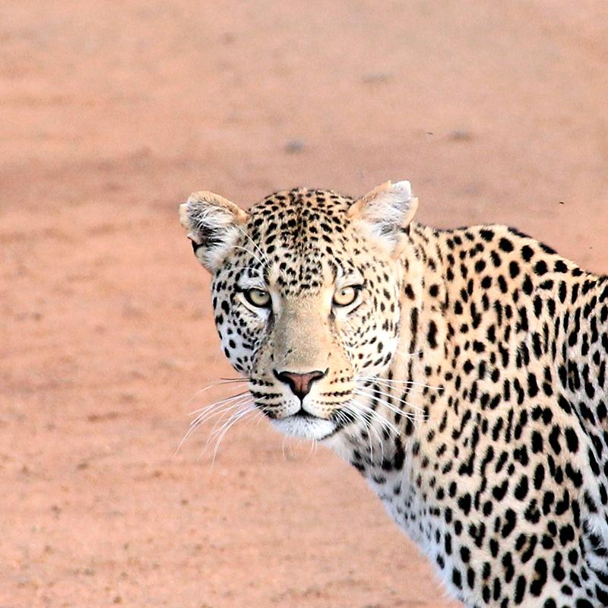
Ardoch
Engagement in the New World:
How can technology help volunteer communication and engagement, instead of hindering?
Connie-Marie Caligiuri
Neshilan Davey
Kat Skull

Slide 2

Realising Children’s Potential Through Education

Slide 3

Technology is nothing. What's important is that you have a faith in people, that they're basically good and smart, and if you give them tools, they'll do wonderful things with them. Steve Jobs

Slide 4

Technology is cool, but you've got to use it as opposed to letting it use you.
Prince

Slide 5
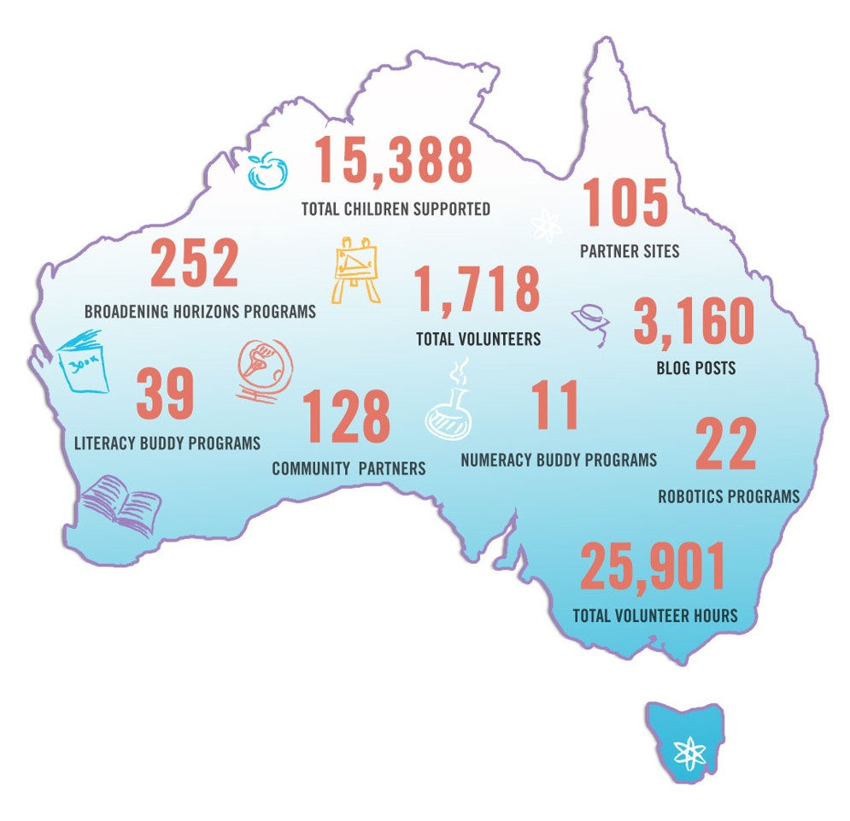
Maps

Slide 6
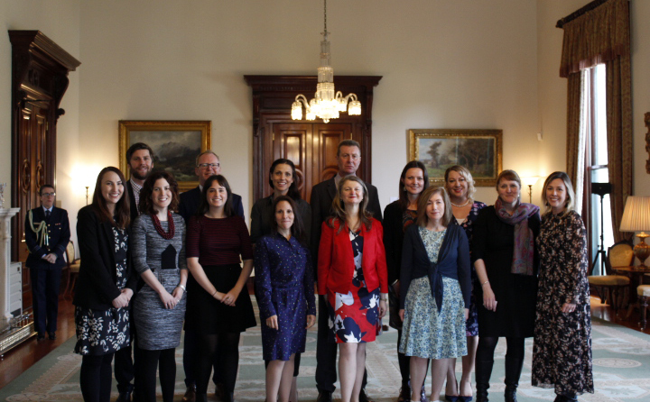
Our Team

Slide 7
25,901
1,718
15,388
Volunteer Hours
Workplace and Education Volunteers
Students across Australia

Slide 8
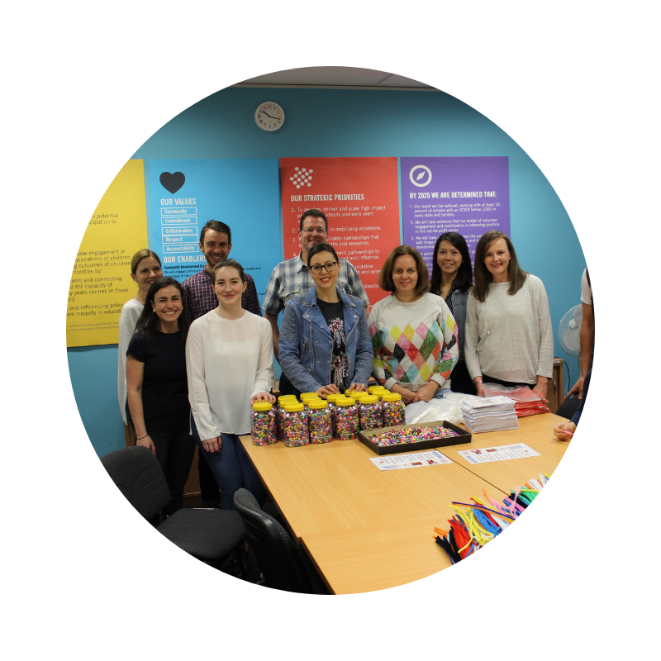
Volunteers
It starts with people.

Slide 9









Who We Work With

Slide 10
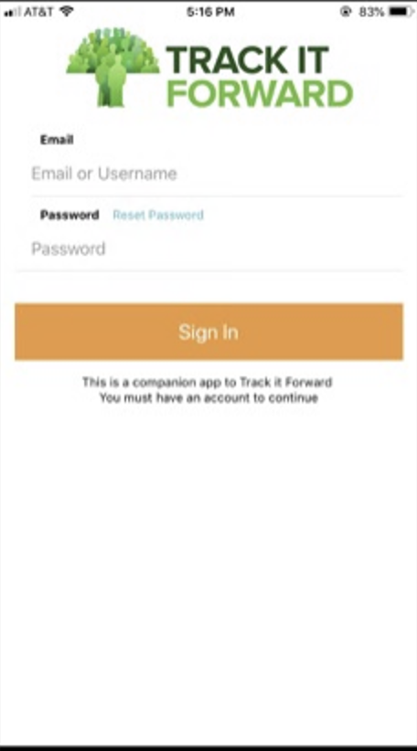
Track It Forward
Place your screenshot here
Flexibility
Up to date reports
Eliminates paper record keeping

Slide 11
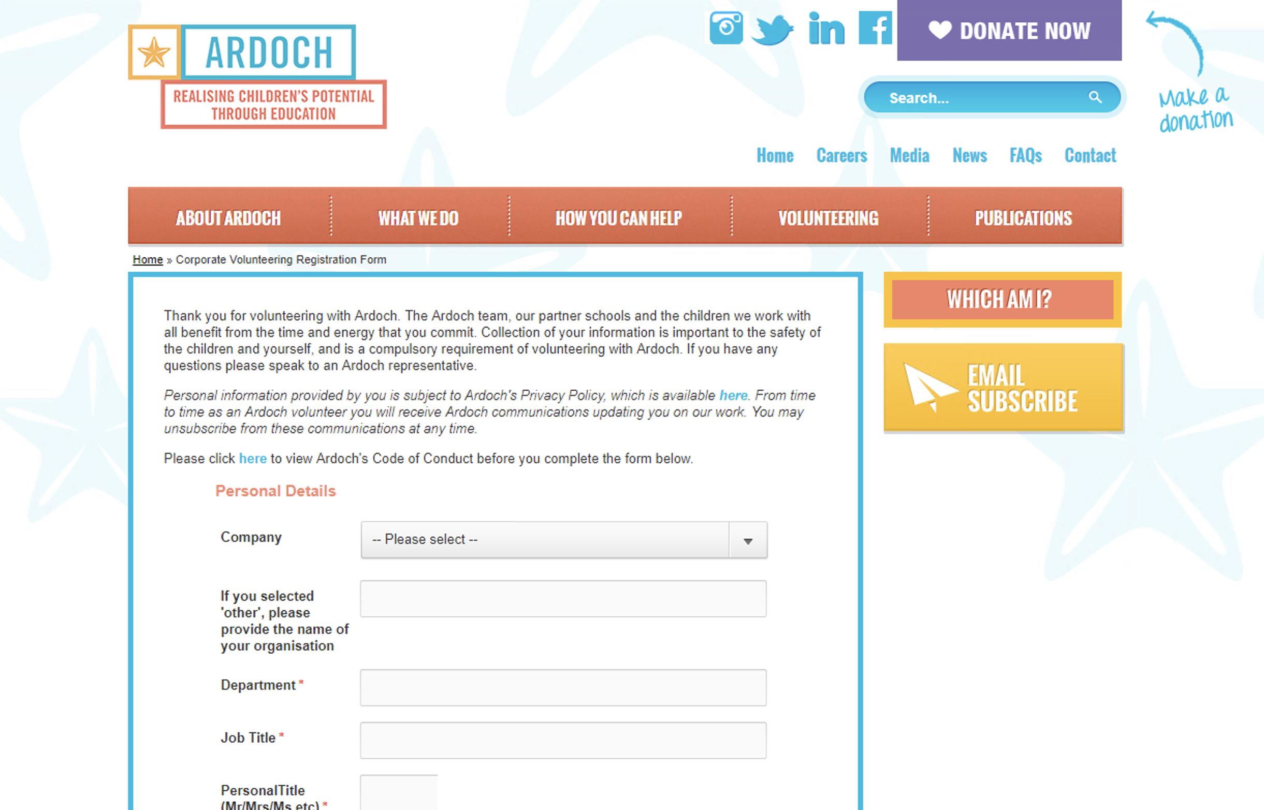
Online Volunteer Registration and Training Portal
Place your screenshot here
Flexibility for busy volunteers
Captures data for CRM
Extends our reach nationally

Slide 12

More of this!!

