Slide 1

Cultural Responsiveness
Workshop overview
Presented by : Yvonne Philips, Manager Volunteers (ss1c@micare.com.au)
Mercedes Sepulveda, Cultural Service Advisor (csa@micare.com.au)

Slide 2
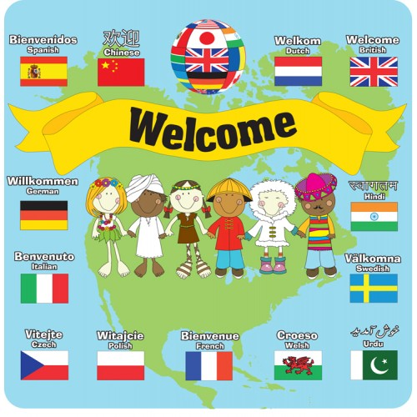

Slide 3
Introduction
Facilitators
Organisation
Workshop process

Slide 4

Residential
256
Countries of Birth: 26
Languages: 14
Religion: 19
Community inclusion and Participation Teams
  Countries of Birth: 19
Settlement Services
  Countries of Birth: 7
  Languages: 9
HSP Service
  Countries of Birth: 7+
  Languages: 10+
HCP Service
  Countries of Birth: 35
  Languages: 31
Senior Clubs
  Countries of Birth: 29
  Languages: 25
Community Services
2404
Cultural Diversity
Community Services
2404
  Country of Birth
  Staff: 33
  Volunteers: 58
  Languages
  Staff: 27
  Volunteers: 50

Slide 5

Rationale
It is imperative that priority is given to training staff and volunteers in cultural responsiveness and cultural specific competencies when working with diversity in a multicultural society.

Slide 6
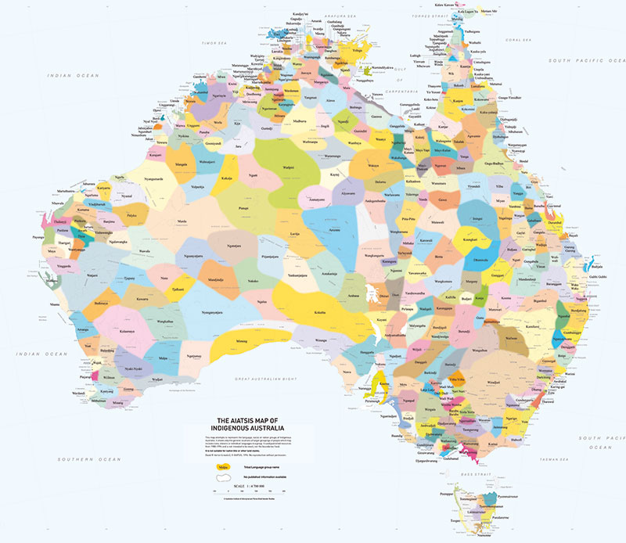
First Nation People Acknowledgement
Notes:
We need to acknowledge that diversity started from our Aboriginal people in Australia
Diversity of ethnic groups/tribes and languages spoken amongst First Nation people is highlighted in this Australian Map
Our intention is to dismistiphy the connotation that diversity is related to migrants and refugees in this society.

Slide 7
Cultural Responsiveness
Cultural Responsiveness definition
The term refers to health care services that are respectful of, and relevant to the health beliefs, health care practices, culture and linguistic needs of diverse consumer/client population and communities.
Cultural Responsiveness Framework Main Principle: Every person has the right to receive high-quality health care regardless of their culture, ethnic, linguistic and religious backgrounds or beliefs.
(Victorian Government Initiative, Dept. of Health, 2009)

Slide 8
Why do we need to know about care provided in a multicultural context?
Australia is a multicultural society
Culture influences how health care and aged care are sought and accessed
We need to adhere to Multicultural Policies that exist at national/state and organisational levels

Slide 9
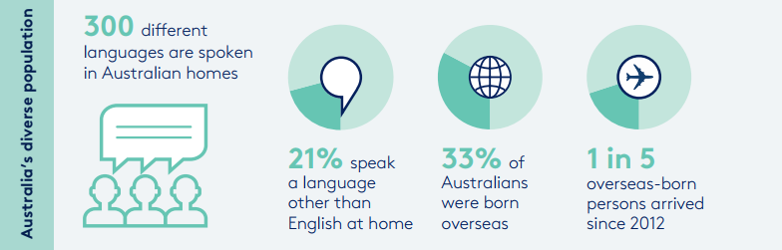
Diversity Today
(Australian Bureau of Statistics 2016)

Slide 10
Care in a multicultural context
If language and cultural barriers are not taken into consideration or not well managed an organisation…
makes services less accessible (access & equity, quality, safety and HR issues are in jeopardise)
increases adverse events and compromises quality and safety of service delivery.

Slide 11
Philosophical Perspective
Key Definition
Human rights
These are rights inherent to all human beings, whatever our nationality, place of residence, sex, national or ethnic origin, colour, religion, language, or any other status, we are all equally entitled to our human rights without discrimination. These rights are all interrelated, interdependent and indivisible.
Notes:
Play the video
Ask for any comments?????

Slide 12
Philosophical Perspective
Key Definition
Social Justice
Is a political and philosophical concept –
all people should have equal access to wealth, health, wellbeing, justice and opportunity.
Social Justice principles involves the fair and proper administration of laws conforming to the natural law that all persons, irrespective of ethnic origin, gender, possessions, race, religion, etc., are to be treated equally and without prejudice.
Notes:
Why Human Rights Approach to Aged Care? (Human Right Approach to Ageing and Health: Respect and choice- 2012)
This approach promotes people’s centred decision-making
Respect for the inherent dignity of older people, as well as endorses genuine change in organisational culture
With a Human Right Approach to Aged Care, the service delivery is non-discriminatory and promotes equality, ensures that services are available, accessible, appropriate and of good quality
Have adequate monitoring mechanism which ensure government accountability

Slide 13
Prejudice
Prejudice is learnt behaviour, usually starts whilst we are children.
Prejudice is baseless and usually is a negative attitude toward members of a group.
Prejudice includes negative feelings, stereotyped beliefs, and discrimination.
Prejudice attitudes views everyone within a group the same way, and fail to really look at each person as a unique individual.
Notes:
We invite you to do participate in a self-reflective exercise

Slide 14
Self- awareness
Experiential exercise
Mnnnn ☺

Slide 15
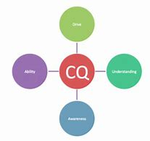
Cultural Competence Key Components
Personal drive
Understanding
Awareness
Abilities

Slide 16

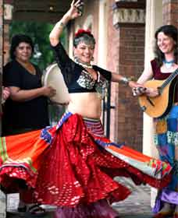
Definitions:
Culture
a way of life of a group of people – behaviours, beliefs, values and symbols that they accept, generally without thinking about them, and that are passed along by communication and imitation from one generation to the next.
the sum of learned behaviours of a group of people that
are generally considered to be tradition of those people.

Slide 17
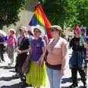
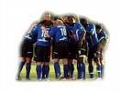
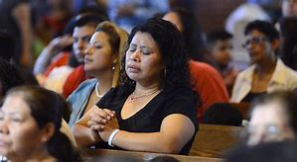
Definitions:
Individual culture: We all have an individual culture as we are members of multiple cultures. We have choices.
Values: The core of culture is formed by values. Good-evil, right-wrong, natural-unnatural. Many values remain unconscious to those who hold them. Values can only be inferred from the way people act under different circumstance.
Cultural belief: different cultural groups think, feel, and act differently. There is no scientific standards for considering one group as fundamentally superior or inferior to another.

Slide 18
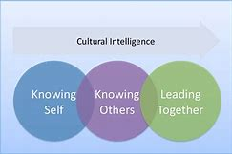
Cultural Self-Awareness
Self-awareness requires understanding of:
  Own values and beliefs
  Attitude and behaviours
  How you differ from others & how similar you are with others
  Ability to understand the differences
Key terms:
  Acculturation: becoming adapted to a new culture
  Assimilation: New culture replaces the original
  Integration: maintain and adopt aspects of both cultures
  (bicultural)

Slide 19
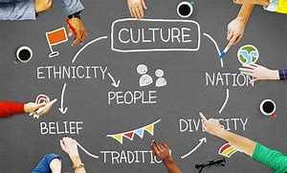
Culture
Everyone has a culture
Culture is dynamic
Culture is learned through socialization
Culture is learned patterns of beliefs, values, attitudes

Slide 20

Cross Cultural Communication
Communication:
respectful, sensitive and sending clear messages
Aim for open communication pathways and understand that:
The way each cultural group communicates with each other and express themselves varies
Language is significant part of individual’s identity
Languages are spoken with different accents and each individual has an accent regardless of the language background

Slide 21

Cross Cultural Communication
Involve your own communication style (body language, active listening and posture)
Communication style impact your ability to achieve satisfactory outcomes
Engage interpreter services when necessary
Custom Vs. Behaviour
Custom:
A practice followed by people of a particular group or region
Behaviour:
The action or reaction to something under specific circumstances

Slide 22
Worldview
Is the way people see the world and how they perceive their relationship with nature, institutions, other people and things based on their life experience.
Effective relationships are tied to an understanding of our own worldview as well as our client’s worldview
Worldview determines how we think/behave/make decisions and define events

Slide 23
Attitude
JUDGEMENTAL
We have a tendency to judge others on the basis of our own values
Positive assumptions need to be checked for validity
ASSUMING
This may cause us to attribute incorrect meanings to the behaviors of others
Negative assumptions are detrimental to positive communication and building positive relationships
Checking and checking all the time is the best way☺

Slide 25
Reflection
Reflective exercise
??????☺

Slide 26
Cultural Diversity/Responsiveness Framework
Australia’s aged care system is evolving to offer increased choice and control for consumers. This transition to person-centred care requires care to be tailored to meet and individual’s diversity needs in a multicultural society.
The Cultural Diversity/Responsive Framework seeks to implant diversity in the design and delivery of aged care; and support action to address perceived or actual barriers to consumers accessing safe, equitable and quality aged care, while enabling consumers and carers to be partners in the process.
(Aged Care Diversity Framework, 2017)
Notes:
MiCare’s Cultural Diversity Framework will be very soon applied across all services to ensure service delivery are culturally responsive and meets the government’s framework criteria.

Slide 27
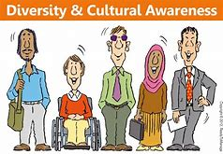
Cultural Safe Environment
Means your cultural values are taken into account & differences are acknowledged and respected and not subjected to:
negative perceptions (stereotypes)
negative attitudes (prejudice) &
negative actions (discrimination)
A culturally safe environment will improve quality of services, outcomes and meet accreditation requirements
Will improve access and equity and human rights are respected.

Slide 28
Person Centred Care
It is a dynamic caring process that maintains autonomy, particularly when older people’s sense of independence is under greater threat. Consider:
  cultural & language barriers
  people are the owner of their history & life
  focus on capacity rather than incapacities
  ask, check all the time, do not assume!!!

Slide 29
Key messages for human connectivity
Irritation/frustration can be a signal that cross-cultural differences are involved – reflect on that = self-awareness
If conflict occurs, more information/clarification is vital for its solution
The client is the best source of information
Cultural diversity enriches human beings and practice standards of any organisation

Slide 30
In a Cultural Responsiveness Approach
Be conscious of the following:
Awareness of your own worldview (self-reflective practice)
Attitude surrounding cultural differences (self-reflective and growing practice)
Knowledge of different cultural practices (ask people – be curious)
Personal commitment to cross-cultural skills (experiential approach)

Slide 31
Practicing
Practice exercise
Ahaah ☺

Slide 32

Responsiveness practices
Working with diversity in the workplace:
it is expected that staff:
value, accept and enjoy cultural differences
communicate effectively with colleagues and clients from other cultures
self-scrutinise own attitude and prejudice toward diversity
understand and adhere personal, professional and organisational values
facilitate a cultural safe environment in the workplace

Slide 33
Questions
???????

Slide 34


