Slide 1
Volunteering Victoria
originfoundation.com.au

Slide 2
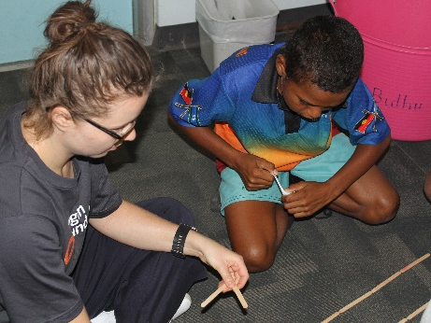
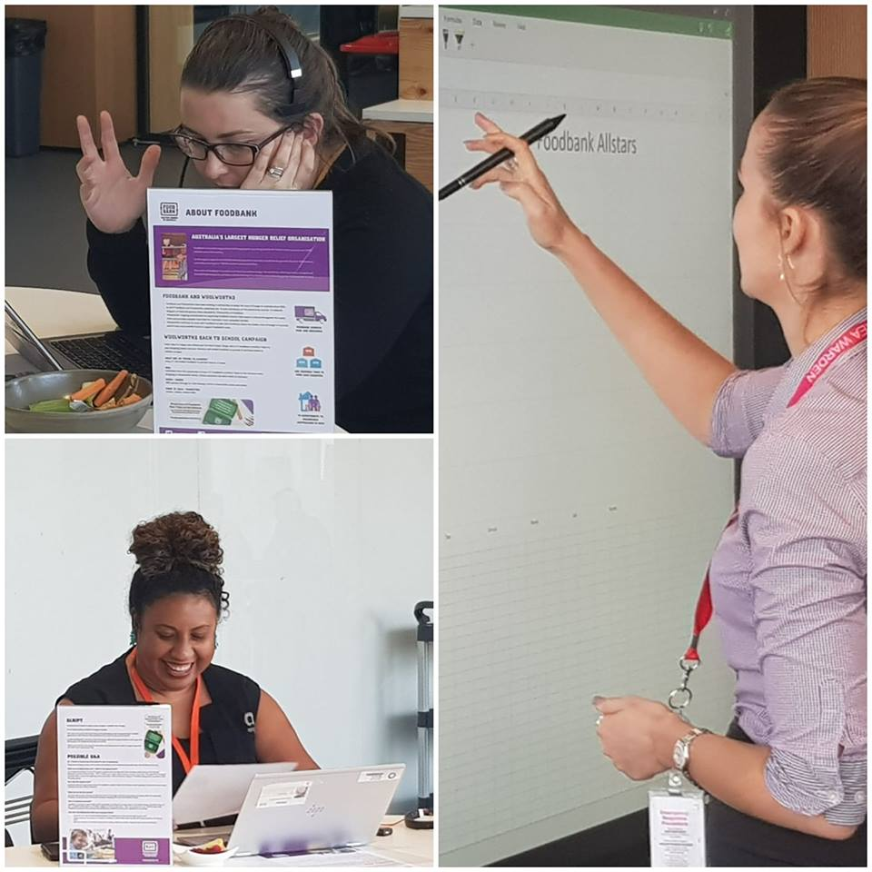
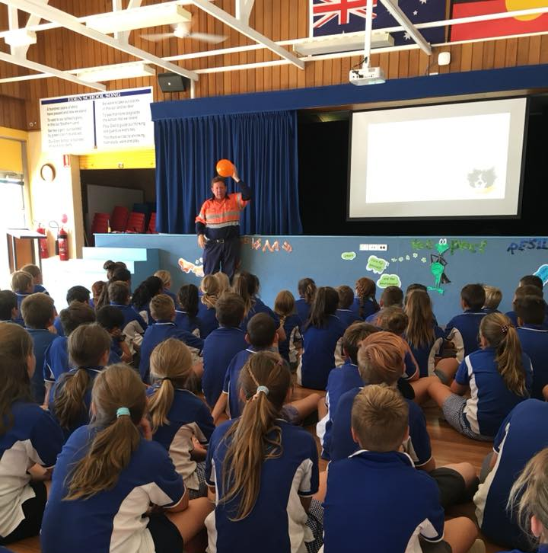
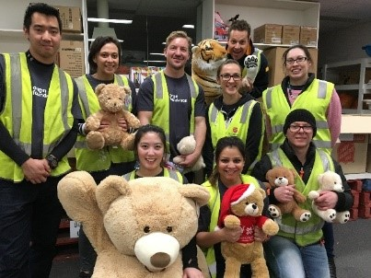
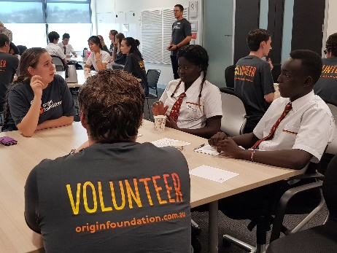
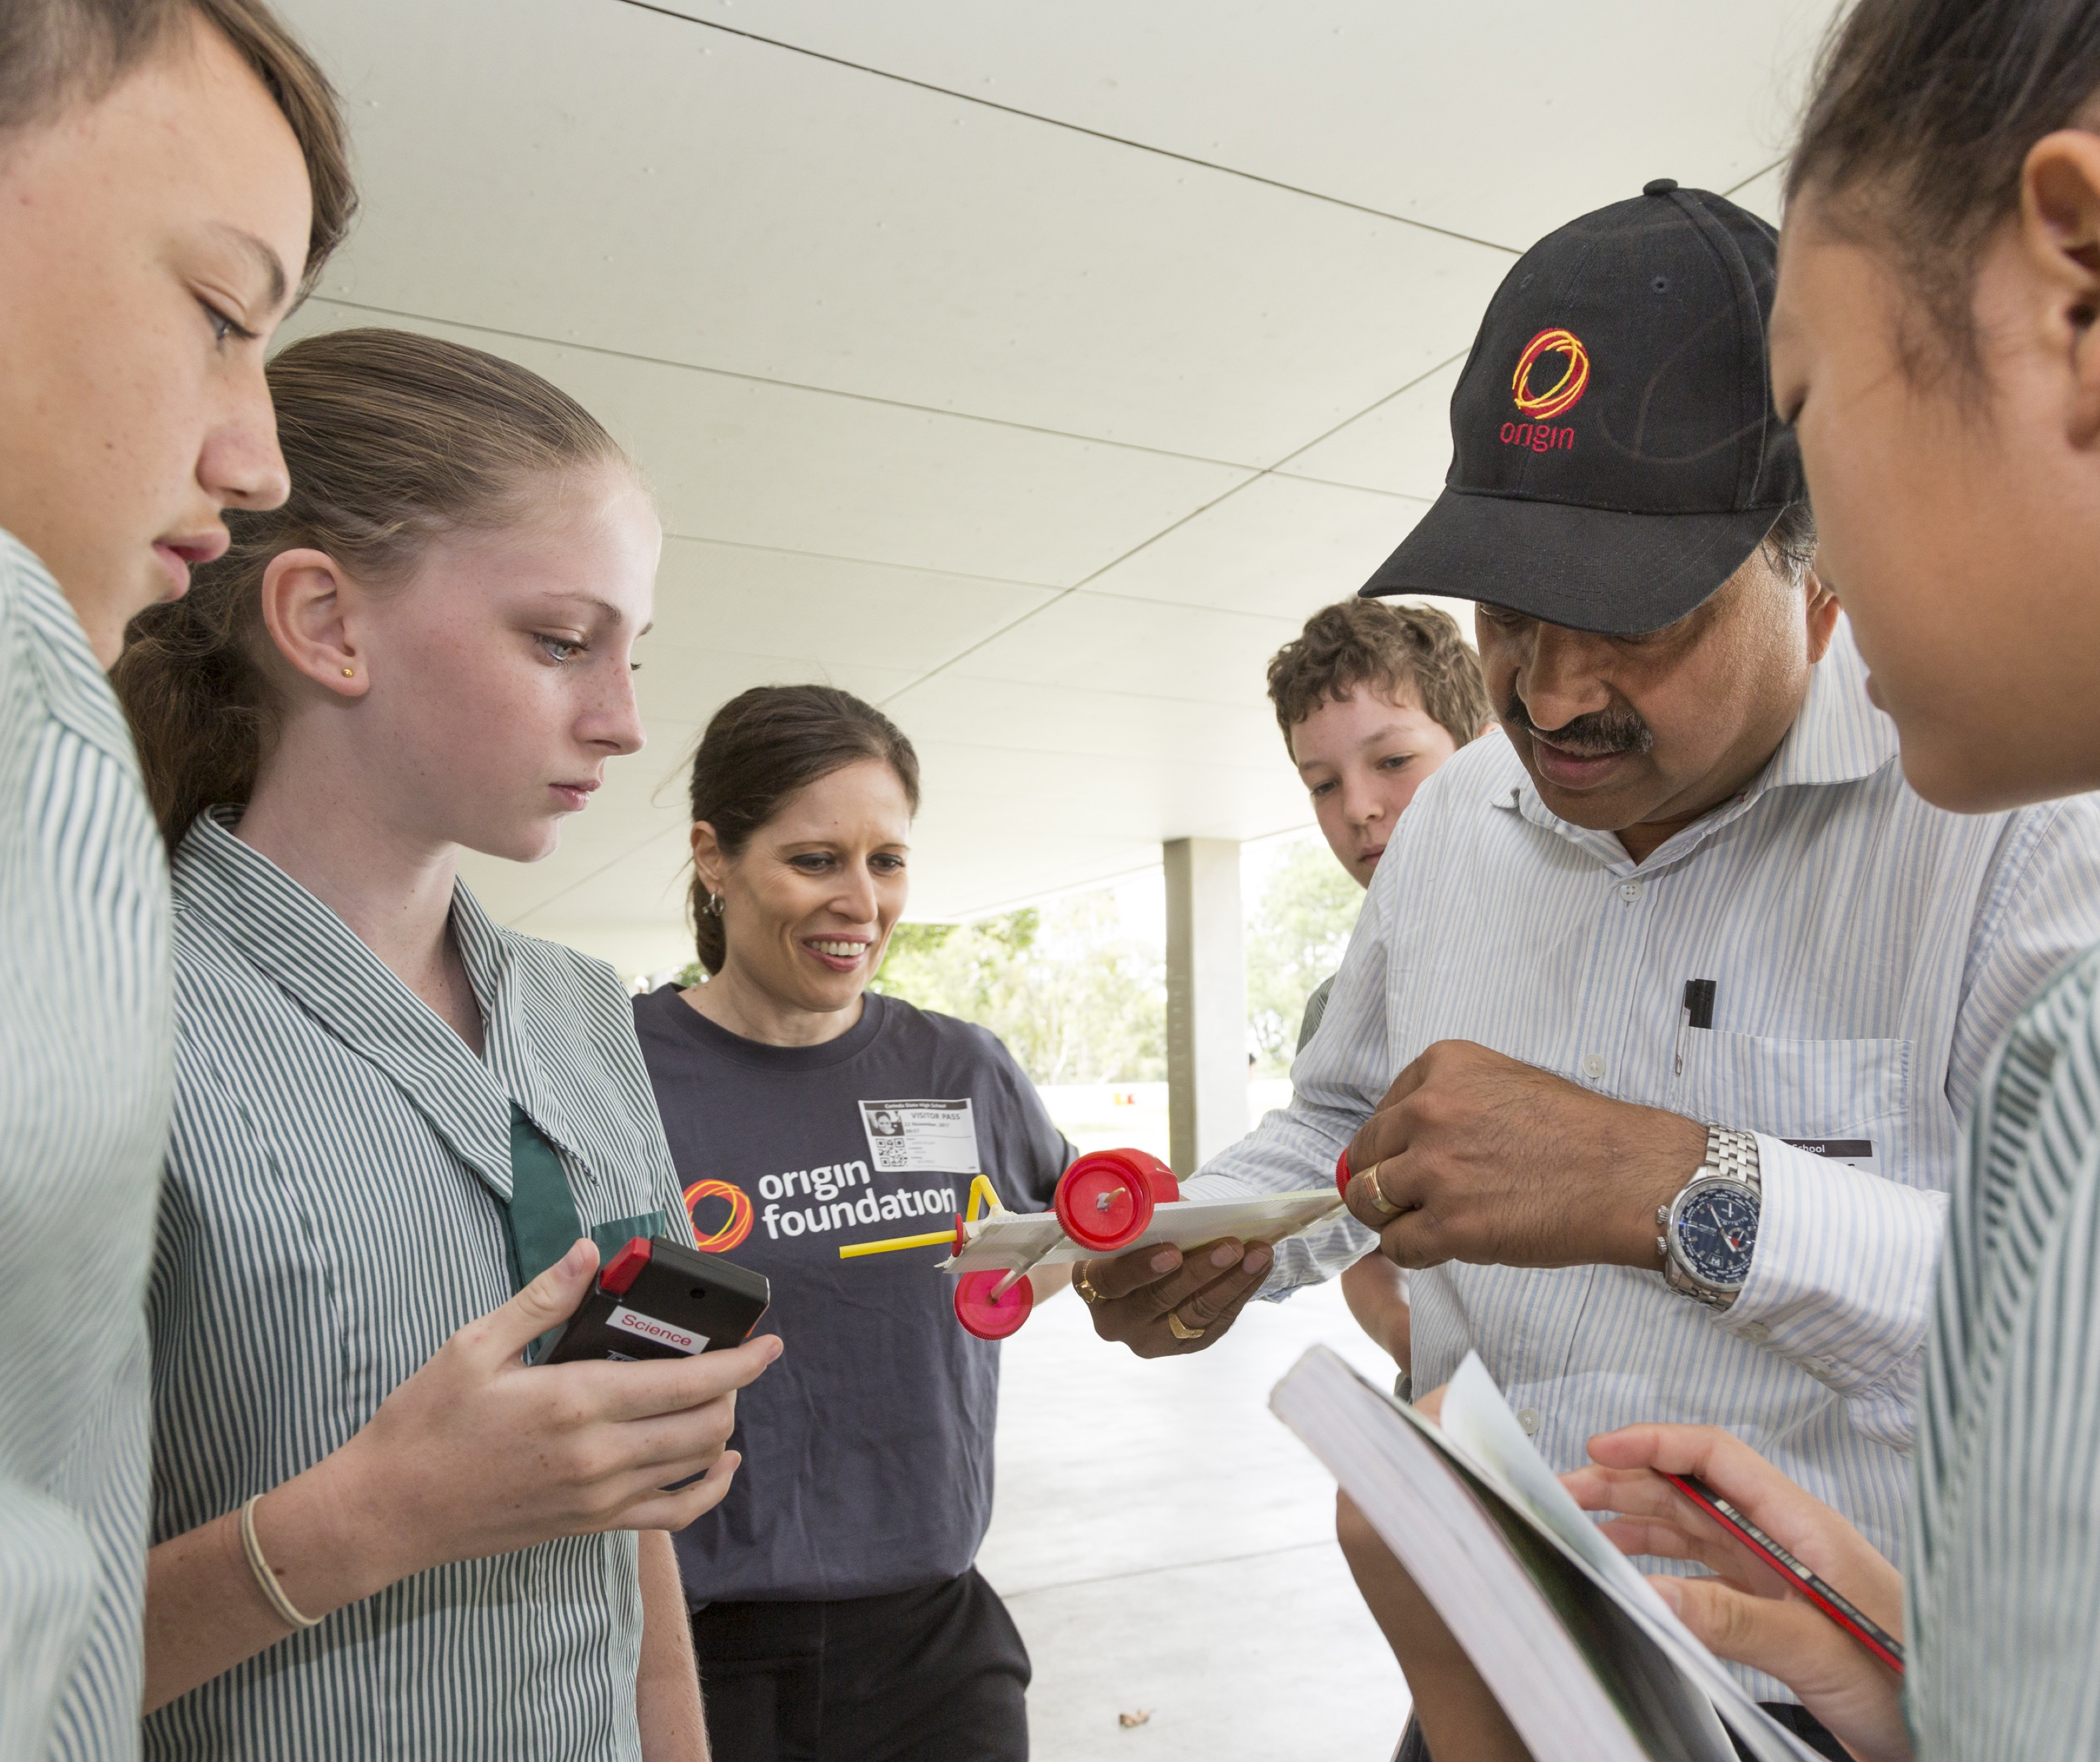
Corporate Volunteering - more than wrapping presents at Christmas

Slide 3
Corporate Volunteering - the Origin Foundation journey
In 2015, we introduced a deliberate strategy:
Align our volunteering program to the Origin Foundation focus on education
Offer a volunteering program which would contribute to employee engagement
Provide volunteering opportunities to build the capacity of our not-for-profit partners

Slide 4
Corporate Volunteering - the Origin Foundation journey

Slide 5
Corporate Volunteering - evolution of our partnerships
Off the shelf | Out of the box
Grant funding | Legal advice to reshape Constitution
Grant funding | Footprint mapped in Origin GIS to support future funding applications
Breakfast for marginalised people | Call centre setup and mentoring to support marginalised women to gain skills and ultimately re-enter mainstream workforce
Warehouse duties – team days | Improvised call centre support for fundraising campaign
Café / warehouse/ gift wrapping – team days | Volunteering forms interpreted into multiple languages for migrants and refugees seeking to volunteer
Assemble solar lights | In schools around Australia Customer relationship management software implementation Quality assurance Origin PNG support distribution to schools in off-grid villages on Kokoda Track

Slide 6
Corporate Volunteering - the what-if conversations…
What if we could?
What if we connected?
What if we collaborated?
What if we overcame the challenges?
What if we made it happen?

Slide 7
Corporate Volunteering - our Guiding Principles
Alignment
Flexibility
Accessibility
Visibility
Meaningful Impact
Notes:
Our volunteering strategy is based on these guiding principles:
Alignment: all volunteering activities align with Origin Foundation focus on education, and/or Origin’s purpose of getting energy right for customers, community and the planet.
Flexibility: To fit varied workloads, operational constraints and partners’ needs, volunteering leave is unlimited and can cover an hour of online mentoring, a total of three days skilled volunteering across several months, or one day out of the office tree planting.
Accessibility: volunteering can be online, at an Origin office or site or an off-site location. Registration is straightforward and logistical support is provided.
Visibility: our volunteers, including senior leaders, are keen to share their stories on our internal social media – exponentially increasing the “feel-good” factor.
Meaningful Impact: volunteering activities are requested by our long-term community partners to meet their specific needs (not “invented” to meet corporate demand). Our volunteers feel that their time is valued and many return to Origin with new skills and abilities.

Slide 8
Corporate Volunteering - more than wrapping presents at Christmas.

