Slide 1

‘Finding the leaders within’
A program of volunteer leadership development.
Sue Jakob. Manager Volunteer Services. Ballarat Health Services
Contact: sue.jakob@bhs.org.au

Slide 2

Inspiring
In addition to helping address a need, three things inspired the development of this program:
Something I inherited
Something I heard
Something I studied

Slide 3

Discovering
The best leader can be found in their own program.
They understand the role of the volunteer in the context of their program
They are familiar with the environment, service, staff and clientele
They know the volunteers in the program
There will be an existing relationship with the Volunteer Coordinator / Manager.

Slide 4
Discovering
What makes a good leader?
Experience as a volunteer
Being positive and non-judgemental, with a strong work ethic
Ability to support volunteers
Ability to train new volunteers
Ability to work with a variety of staff

Slide 5

Supporting & Developing
Supporting and equipping team leaders with the skills and information they need will help them effectively lead a group of volunteers.
A structured approach includes:

Slide 6
Supporting & Developing
Begin with a position description:
Statement of purpose
Outline of duties
Selection Criteria
Other, such as time commitment, direct reports

Slide 7
Supporting & Developing
Conduct a training needs analysis:
What skills are required, based on the PD?
Where is training required?
What is the best method to deliver training?

Slide 8
Supporting & Developing
Training forums include:
Formal training, expert driven, either internal or external
On-line modules
Information sharing, such as policies
Attendance at staff meetings
Regular meetings with Manager

Slide 9
Supporting & Developing
Regular meetings with Volunteer Manager are most valuable:
Volunteer manager is kept informed
Relationships are developed
Issues highlighted and addressed
Team leaders kept up to date
Team leaders are coached and guided
Team leaders feel supported

Slide 10

Managing the issues
Managing volunteers in the program:
Team leaders may be the ‘first port of call’
Team leaders may be confident to manage issues themselves or
Report to Volunteer Manager

Slide 11
Managing the issues
Managing team leader issues, such as
Illness
Blurring of role boundaries
Taking on too much

Slide 12
Managing the issues
These can be managed by ensuring:
A clear PD is in place (perhaps even referencing what the position is ‘not’)
Attendance at monthly meetings
There is a ‘deputy’ team leader
Regular leave is taken
The team leader is aware of EAP or other support programs

Slide 13

Benefitting & Impacting
There are many benefits of establishing a Team leader program.
The program
The clients
The volunteers
The Team Leader
The Volunteer Manager

Slide 14
The National Standards for Volunteer Involvement
This program supports a number of criteria across several standards.
Standard 1: Leadership and Management
Standard 3: Volunteer roles
Standard 4: Recruitment and Selection
Standard 5: Support and Development
Standard 6: Workplace Safety and Wellbeing

Slide 15
And in conclusion…
A well-structured and managed Team leader program will enable the Volunteer Manager to run individual programs more efficiently, benefitting the client and enhancing volunteer engagement. It provides unique opportunities for individuals to take on positions that they may not have otherwise done, and adds a lovely layer of support Volunteer Managers.
Find the leader within the program, and you will discover the leader within the volunteer.

Slide 16
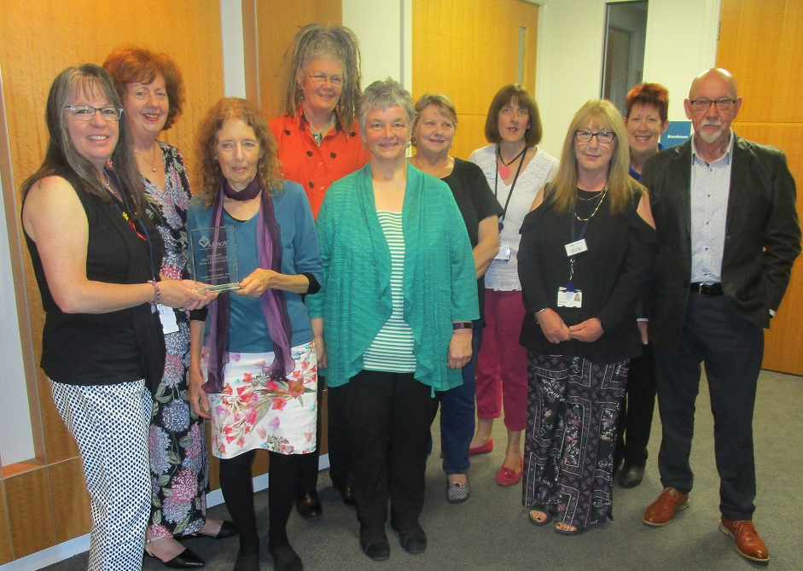
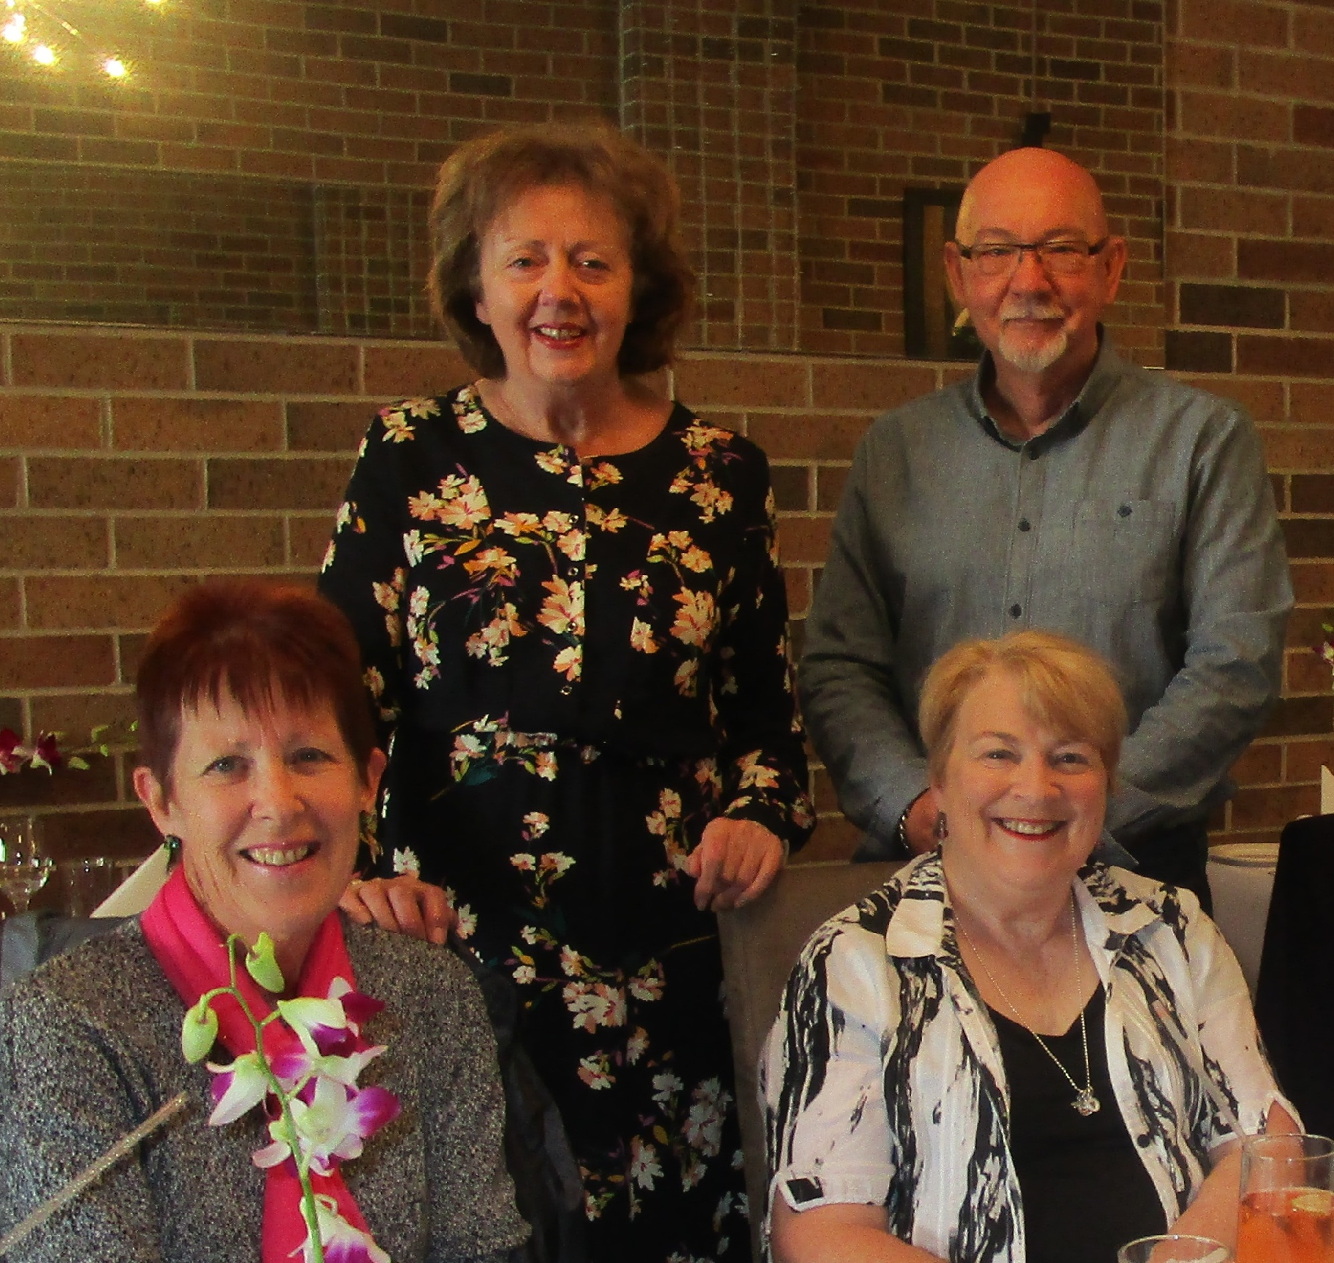
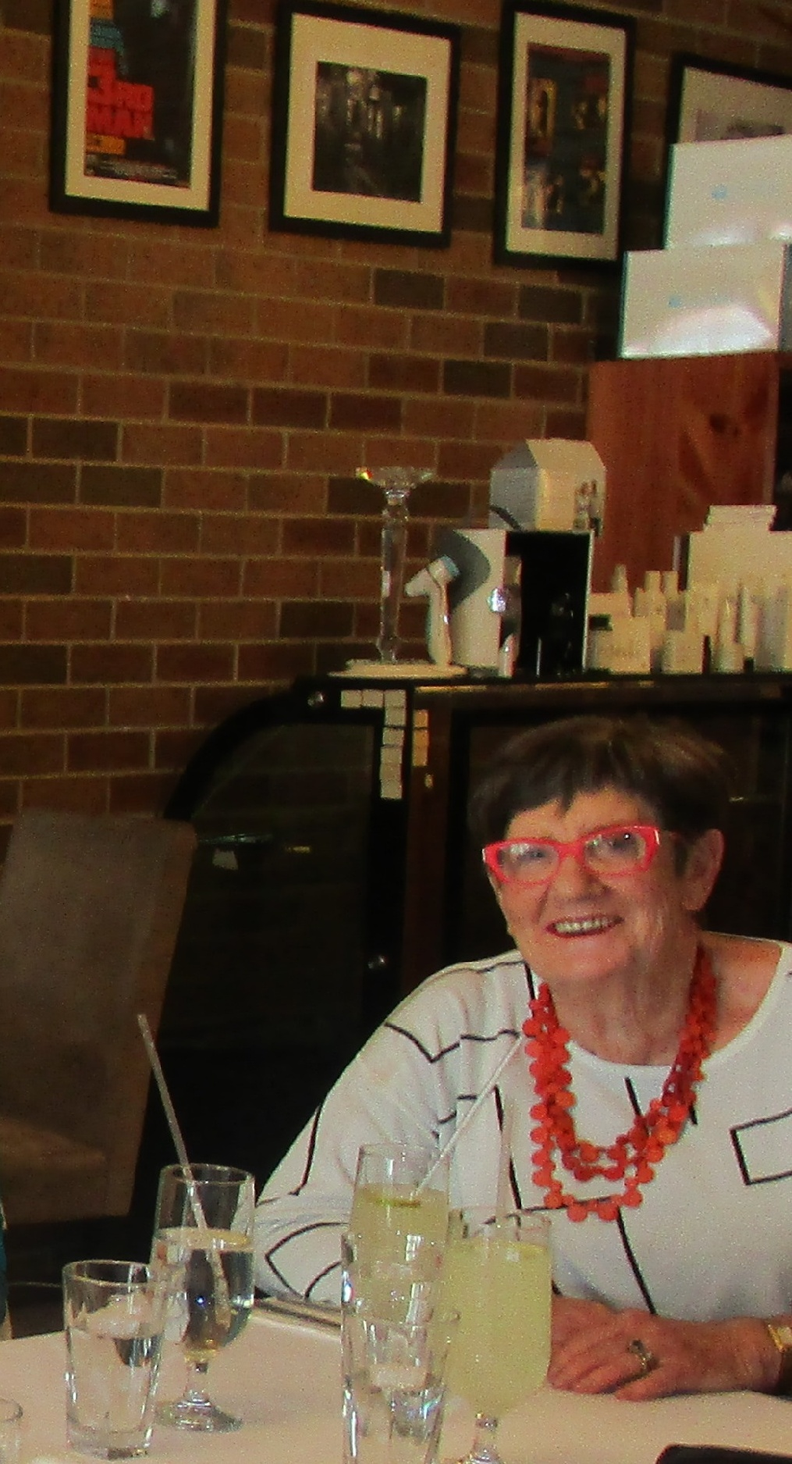
And in conclusion… here is my award- winning team!
Winners of the 2018 Australasian Association of Managers of Volunteers Award for Excellence, in the Team category.

